Slide 1
Dependencies – The Arch Enemy
David Sackstein, CodePrecise

Slide 2
Agenda
The Cost of Dependencies - Loose Coupling
The Coffee Shop Principle
Entropy Again – Do Not Repeat Yourself
Isotopes, Nuclear Fission – High Cohesion

Slide 3
Dependencies in Software
Dependencies in software are like gravitational forces that link software components.
As a software system grows the pressure of its dependencies become greater than the forces that keeps components apart.
Large interdependent systems eventually swallow all resources invested by developers.

Slide 4
The Cost of Dependencies
If A depends on B then changes to B affect A.
If B depends on C then changes to C affect A and B
Dependencies make it difficult to isolate functionality
Examples of dependency: inheritance, the new operator, type usage

Slide 5
The Cost of Dependencies
Introduce bugs that are difficult to track.
Lack of predictability
Limit maintainability and extensibility of code
Discourage programmers from refactoring.
Increase the learning time of existing code
Prevent fine granularity in testing
Increase set up time for testing

Slide 6
Unnecessary Dependencies
The benefit of dependencies should be pessimistically weighed against their enormous cost.

Slide 7
Loose Coupling
Minimize the number of dependencies between components and classes.
Depend on abstractions not on concrete types.
Minimize the number of methods in interfaces.
Principle of Least Knowledge

Slide 8
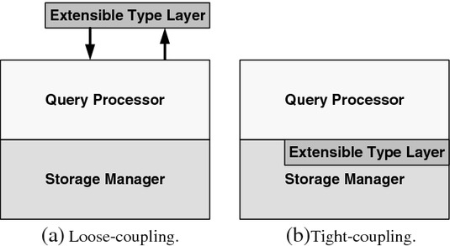
Loose Coupling vs. Tight Coupling

Slide 9
The Coffee Shop Principle
Any code you work on should allow you to:
  Pack it up in a zip of a few 100K
  Develop, test, and debug it on a laptop in a coffee shop with no internet connection.
If this is not possible you have too many dependencies.

Slide 10

Work in the Coffee Shop

Slide 11
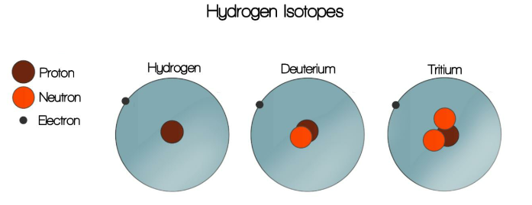
Isotopes
An isotope is a variation of the same element with a different number of neutrons

Slide 12
Nuclear Fission
Protons electrically repel each other.
The “strong force” binds protons and neutrons together. It diminishes rapidly with distance.
Therefore large nuclei become unstable.
Uranium-238 has 92 protons and 146 neutrons. Uranium is unstable.
Unstable isotopes undergo radioactive decay.

Slide 13
High Cohesion
Think of a class as the nucleus of an atom
Methods and fields are neutrons and protons.
The responsibility of the class binds them together.
As the class grows it becomes unstable.
Split large classes into smaller cohesive classes, each with its own responsibility.

Slide 14
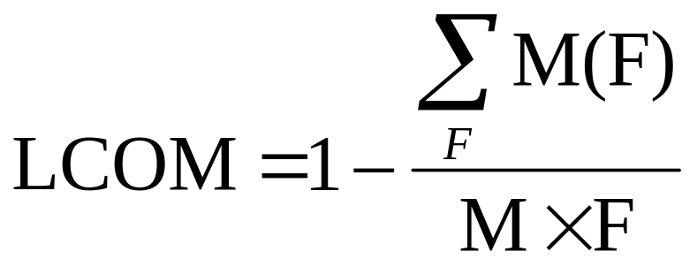
Lack of Cohesion Of Methods
M - The number of methods in a class
F - The number of instance fields in the class.
M(F) - The number of methods of the class accessing a particular instance field

Slide 15
Entropy Again
In information theory, Shannon Entropy is a measure of the amount of information content in a message.
Entropy is the minimum number of bits that are needed to represent the message.
Useful in measuring the efficiency of lossless compression algorithms.
Notes:
The concept was introduced by Claude E. Shannon in his 1948 paper "A Mathematical Theory of Communication".[

Slide 16

Don’t Repeat Yourself
Invest energy so that the size of your code approaches its entropy

Slide 17
The Pros and Cons of Duplication
Cons:
  Bugs need to be fixed in more than one place.
  Raises questions: Are they different? Why? Intentional or not?
  Code bloat increases build times.
Pros
  Duplicating code reduces dependencies.
Notes:
The concept was introduced by Claude E. Shannon in his 1948 paper "A Mathematical Theory of Communication".[

Slide 18
The Code Reuse Dilemma
Code reuse prevents duplication
Code reuse introduces dependencies
Reusable code is cleaner and more testable

Slide 19
Resolution
Always write reusable software
But you don’t always need to reuse a reusable component
Whether you do is a cost-benefit decision in each case. In particular - how the component is version controlled and supported.
Remember: Duplication is a lesser evil than introducing dependencies

